Slide 1
Understanding and interpreting Deep Neural Networks
:Cameron Railton
Notes:
Hi, my name is Cameron Railton and today I will be presenting to you the subject of how we can build our models in a way that can let us understand and be better able to explain how a Deep neural network came up with its prediction. This will help us optimize our models by showing us valuable features or even help us take out features that we did not want the model to be using. Without these techniques it would be much harder or impossible on some complex models to see exactly how our model came up with its answer. It is harder to rely on the accuracy of a model if we are not able to see it is innerworkings, but if we can have some insight on the feature the model is using to come up with its answer, we can have more confidence in it and even gain new insight on the methods it uses.

Slide 2
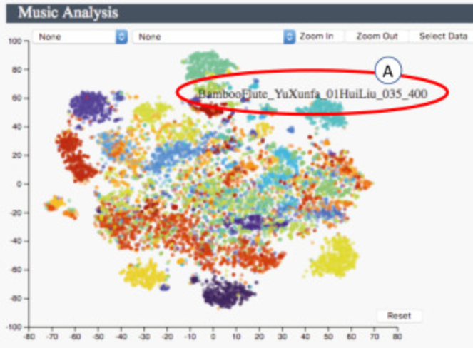


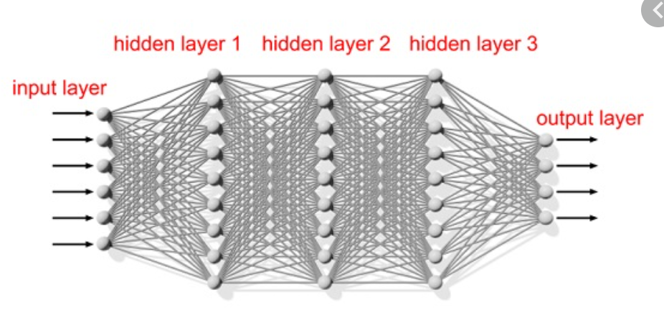

Defining some terms
Interpretation: Giving meaning to an abstract concept
Understanding: Knowing how much and which of the collection of features have contributed to that answer
Uninterpretable:
Notes:
Before we continue, I will be defining some terms for the context I will be using them in. An interpretation is taking an abstract concept that does not have any meaning to us and mapping that to a domain where we can get some meaning. For example, if we look at the integer values that make up an image it would be hard to know what those numbers represent, but if we look at the actual-colored image, you would be able to interpret it and know what that image represents. We are all able to interpret songs, images, and text but we are not able to interpret other, more complex forms of data like, large abstract Vector spaces, or the CS3331 Final. Where unable to make sense of them, however we can map their data to a domain that we can interpret. The other term is Understanding, which we can define as all the features that we can interpret and the weight that they have on the result we are interested in. For example, to understand how a classifier is making its predictions. We must be able to interpret the important features the model uses and how much they affect the model’s prediction.

Slide 3

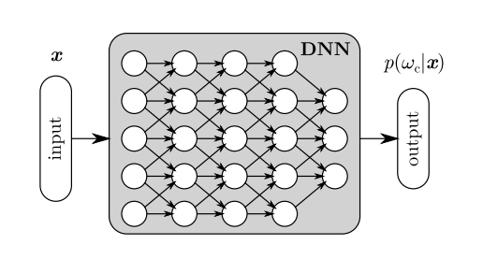
Deep Neural Net
Input layer is interpretable most of the time
Cannot interpret the hidden or output layer values
Notes:
A Deep neural network consists of a collection of neurons organized in layers. These neurons can be fully connected to the neurons of its neighboring layers or only connected to a subset. Data is fed through the input layer where it is passed along by each of the other layers, to the output layer. Each neuron receives the previous layers activations as input, multiplies the inputs it receives by a weight, sums those values up and feeds that to its own activation function. For the most part we can interpret the input values we feed into the input layer, which could be text, images, or sound files, but were unable to interpret the data as it passes through the hidden layers of the network. To make sense of it we use prototypes to visualize data to make it easier to interpret. Prototypes are a representation that reflect properties of a collection of data.

Slide 4
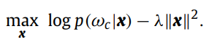
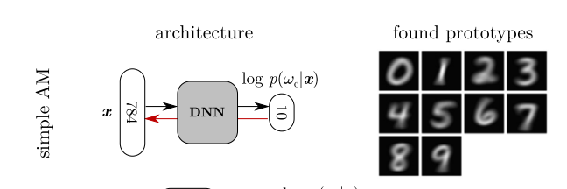
Activation Maximization
Find the input that gives the highest response for that class (ex. ,1 ,2)
Prototypes can look unatural, since the prototype is made by maximizing the response of the class and not considering input data
Notes:
One method to create these prototypes is using the Activation Maximization analysis framework. Since the probabilities modeled by the Deep neural network are functions with a gradient, we can use gradient ascent to find the highest model response for a class given the optimized x value. As we can see this method makes strong recognizable prototypes but can look slightly blurry and unnatural because of the use of the l2 norm regularizer.

Slide 5
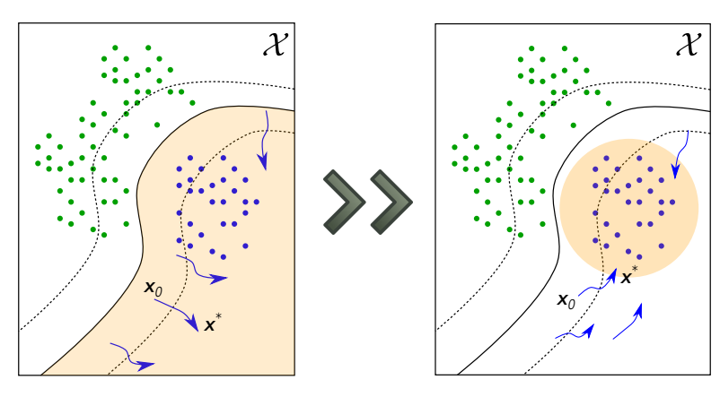
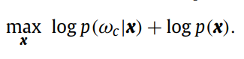
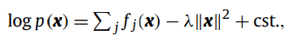
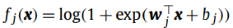
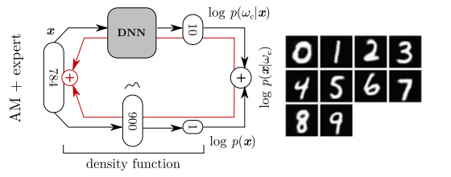
Improving AM with an Expert
Where:
Maximize the probability of the class given x, plus
Notes:
We can improve these prototypes by replacing the L2 regularizer and introducing an expert to the equation. The expert is a function that models the data. Using bayes rule we change what we are looking for, from looking for the input that would return the highest response for a class. To also considering the probability of the inputted data given it is from that specific class. Our new expert prototypes consider what the input data should look like in a given a class. The prototypes made are more defined and natural looking compared to having the l2 norm regularization.

Slide 6
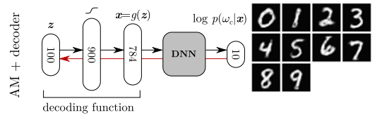
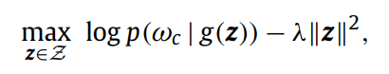
AM with Decoder
Decoding function (g)
maps z -> X
Which then maximizing the probability of that class given x can be solved for
Notes:
Data density models that we use with experts can be difficult to make accurate and can be complex, making them hard to maximize. To solve this problem, we use a new class of unsupervised models called generative models. These models do not use the density function directly but samples from a simple distribution q(z) in some abstract code space. The decoding function g : (Z -> X) lets us generate a data distribution that is hard to discriminate from the true distribution. We learn this decoding function in competition with a discriminate between the regular and generated distributions. Once we optimize the equation for z we can get a prototype for the class by putting z through the decoder function . These prototypes do suffer from being less accurate since they work with the data distribution we create. They do have the added benefit of being easier to maximize and still give a sharp and clean look.

Slide 7
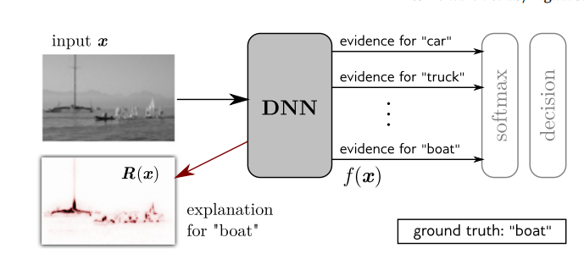
For more complex problems we must change what we are looking at
From "what is a good prototype of the class"
To" What features make the data look like the class."
Notes:
Complex machine learning problems have probability functions that might be multimodal and make it so no single prototype can fully represent what we want to classify. For example, if were looking at classifying boats it would be hard to create a prototype that could be representative of all the possible boats we can have. Some features that help predict if theres a boat in the picture might also not even be part of the boat at all, like if a model was also considering the water in the background as a feature. Introducing some locality by focusing certain regions of the input space let us change the question From “what is a good prototype of the class” to “What features make the data look like the class.” A simple approach to this problem is to look at the input data as a collection of features, with their given weights. Then having the network look at those to make its prediction..

Slide 8
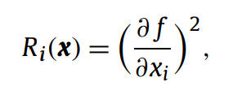
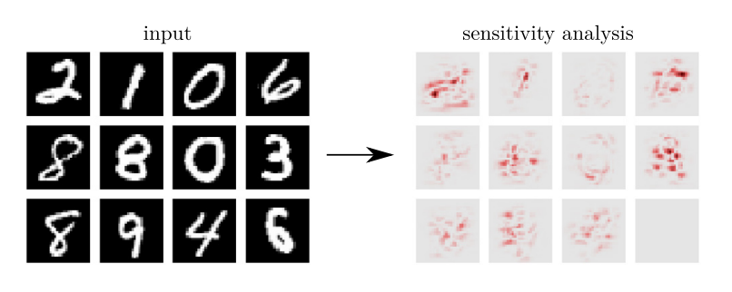
Sensitivity Analysis
Relevance score =
We compute a relavence score for each pixel
Shows which pixels are highly relavent to decision but not why
Notes:
Sensitivity analysis is a way to identify which part of an image is most relevant to a specific class. It does this by evaluating a relevance score to each individual pixel calculated by getting the gradient of a function that relates x to a class. We can see which input features are more relevant to the decision based on which affect the output the most. The darker the red parts of these prototype means it is more relevant. Since sensitivity analysis's relevance score relates to the local variation rather than the function value itself the prototypes it produces only show pixels that are strongly related to the class and we are not able to tell why is strongly related.

Slide 9
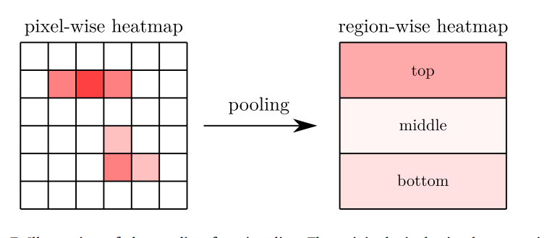
Data Pooling
Pixel heatmaps are not continous which can make it hard to interpret important regions
Having a pooling layer to calculate the average of a patch of the image can help show which regions the model is giving importance too
Notes:
Having many features that the function gives relevance can make the heatmaps harder to interpret. The heatmaps of the relevance can be discontinuous and scatter some of the important pixels. Having a layer to pool these pixels together allows us to average out these pixels. This allows us to be able to see the more general regions the model is looking at and how important it is.

Slide 10
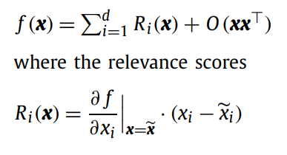
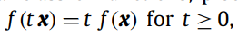
Simple Taylor Decomposition
F(x) = the sum of relavence scores plus a high order term
Since the first order terms contain higher order value and are tipicaly non-zero, we can add in a piece wise function so we can define f(x) better
x = data point
X(tilda) = value that makes f(x) = 0 and is close to x
Notes:
One of these functions is the ReLu function, we can model these multiple features in a way that makes it appear linear and allows us to optimize the features of a class using gradient decent. The function lets us simplify our equation since where able to find a root near the origin that has a limit that approaches zero and lies in the same region as x. Simplifying f(x) to this equation. Where f(x) is the sum of relevance scores and the relevance score is calculated by multiplying the slope of the function relative to the point of x, times the point of x. High relevance scores are attributed to the feature being in the data and if the model sees it as a strong feature.

Slide 11
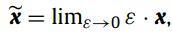
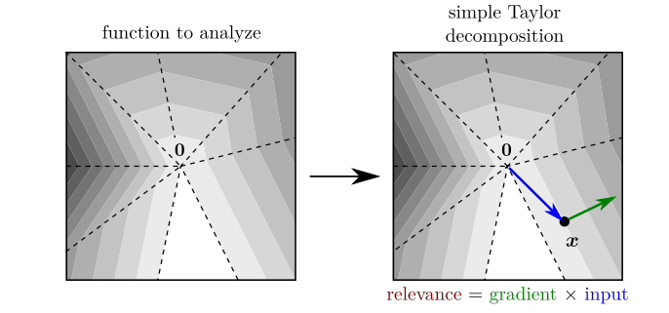
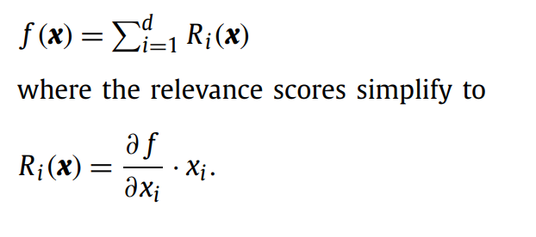
Simple Taylor series simplified with ReLu networks
We pick a root value that has a limit approching zero
High values in dark grey
Zero is in white
Dashed lines = seperations of linear regions where gradient cannot be calculated
Where then able to simplify f(x) and the relevance scores to
Notes:
One of these functions is the ReLu functions, which allow us to model these multiple features in a way that makes it appear linear and allows us to optimize the features of a class using gradient decent. The function lets us simplify our equation since where able to find a root near the origin that has a limit that approaches zero and lies in the same region as x. Simplifying f(x) to this equation. Where f(x) is the sum of relevance scores and the relevance score is calculated by multiplying the slope of the function relative to the point of x, times the point of x. High relevance scores are attributed to the feature being in the data and if the model sees it as a strong feature.

Slide 12
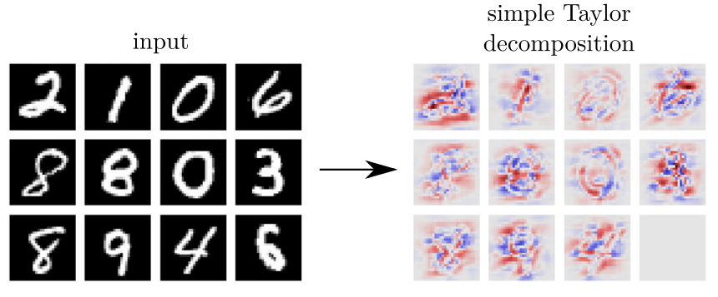
Taylor Series Results
Pro: More complete than sensitivity analysis and has negative relevance values
Con: Has a high amount of negative relevance in places that go with calss since we only aproximate x
Notes:
Using simple Taylor decomposition gives us many benefits in interpreting the data compared to sensitivity analysis. One big difference in the heatmaps is that they are much cleaner, and you can see the definition of the classes better. The other major difference with simple Taylor decomposition is that it returns negative relevance as shown in blue on the heatmaps. This can give us insight onto what the model is not looking for in a specific class. However, since the root we used only approximates x, the heatmaps contain a lot more negative relevance than it should have. The closer the root we pick the more accurate the relevance in the heatmap will be, however we can not always get a close x value. decomposition is that it returns negative relevance as well shown in blue on the heatmaps. This can give us insight onto what the model is not looking for in a specific class. However, since the root we used only approximates x the heatmaps contain a lot more negative relevance than it should have. The closer the root we pick the more accurate the relevance in the heatmap will be however we can not always get a close x value.

Slide 13
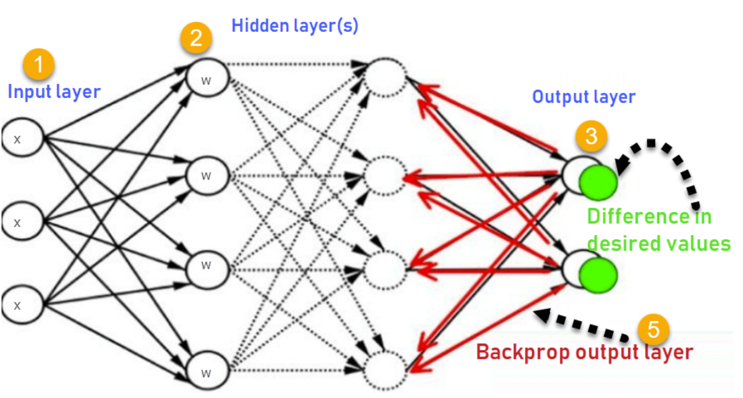
Backpropagation
With relevance conservation:
Relevance is passed on equally from the node to its predecessors
Hyperparameters control negative relevance feedback
Uses max pooling
Been shown to scale better
Uses ReLu activations to propogate signal to apropriate location of image
Non-conserving
Notes:
Backpropagation is another way of understanding a neural network prediction. In this method we start at the output of a network and then we go through each layer mapping the predictions of the higher up layer to the lower layer. There are two kinds of ways we can propagate this relevance back to the input layer. The first type is non relevance conserving, where relevance is not conserved between nodes and layers. The second type is relevance conserving where we enforce rules so that when we propagate the relevance back through the network, the share of relevance received by each node is redistribute in the same amount to its predecessors.

Slide 14
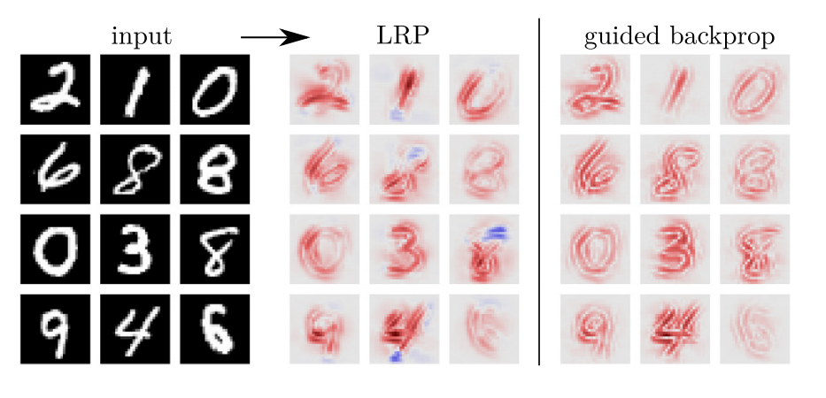
Benefits of backpropagation
Back propagation provides clearer prototypes
Don’t suffer from high degree of negative relevance
Able to filter out neurons
Notes:
As you can see the prototypes created from backpropagation methods seem to be even clearer and do not suffer from the large amount of negative relevance as the Taylor series decomposition and they scale better. Backpropagations also has the added bonus of being able to use a filter to block the propagation or certain neurons. Filters can be used when some of the hidden layer’s neurons are specific to a certain task and others, are shared among tasks. Filtering one or the other will let you see what is relevant to that certain task and what is relevant to all tasks.

Slide 15
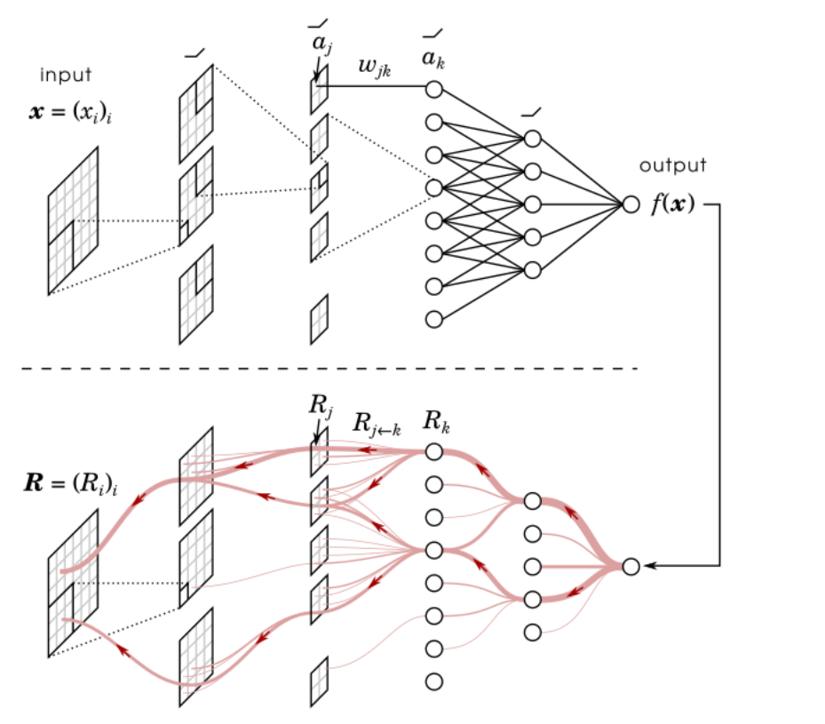
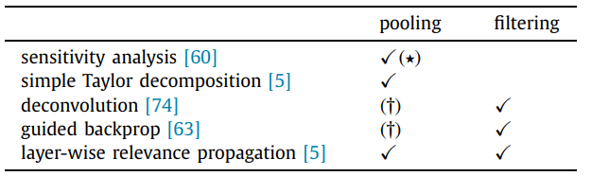
Layer-Wise relevance propagation
Phase 1: data goes through the network and activations are recorded
Phase 2: output is propagated back though network to input layer
Notes:
Layer wise relevance propagation is a conserving backpropagation technique which can use filtering as well as max pooling. It was designed to provide a greater explanation on what is happening within its layers and to be relatively efficient to other techniques. Layer wise relevance propagation has two phases. The first phase is a normal pass through the network where the activations of each neuron are collected. Then in phase two, the outputted relevance is then propagated back through the network to the input layer.

Slide 16
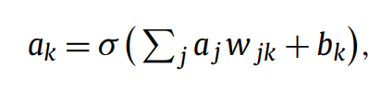
LRP relevance conservation
neurons are described by:
σ = monotonically increasing activation function
aj = activations of previous layer
W = weights
B = bias
Notes:
We implement the conservative property of Layer wise propagation by having a specific set of propagation rules the network must follow. We let the activations of our neurons be modeled by this equation. Where sigma is an always increasing activation function that takes in the sum of the previous layers activation and times that with the current neuron’s weight plus its bias term.

Slide 17
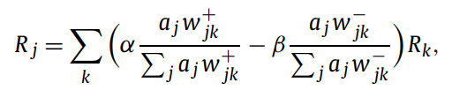
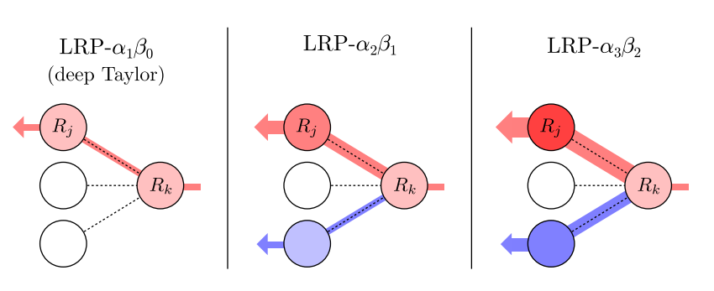
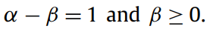
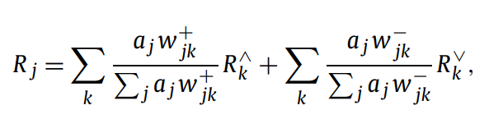
LRP α β - Rule
A b – Rule:
Using this property:
We can rewrite the equation as:
Notes:
One propagation rule that has been shown to work well with Layer wise propagation is the alpha beta rule. Using this rule where able to propagate to the lower layer the positive relevance in proportion to how excitatory it is to the neuron, as well as the negative relevance in proportion to how inhibitory it is to the neuron. As you can see in this figure the positive relevance (in red ) and negative relevance( in blue) is being passed on to the lower layer neurons. We also need to add a constraint on values of alpha and beta to have a difference equal to 1 and not letting beta be less than zero. Small terms might need to be added to avoid a division by zero.

Slide 18
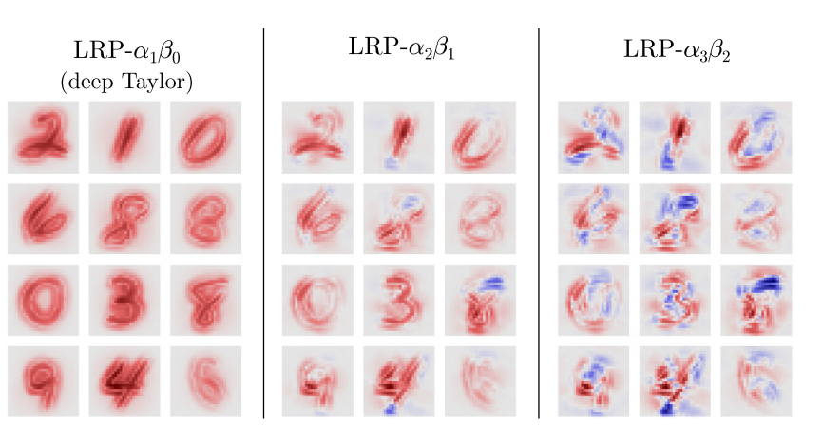
α β Values
LRP-α1β0
0% negative relevance in heatmap
Equivalent as doing taylor decomposition between layers
LRP-α2β1
5% negative relevance in heatmap
Most commonplace
LRP-α3β2
5% negative relevance in heatmap
Notes:
The alpha beta values we chose affect the amount of relevance will that will be created in the propagation phase. Having both be high values will therefore create a high degree of relevance on the prototypes. Different values have been shown to work well on different classification problem, but it is commonplace to let alpha be equal to 2 and beta be equal to 1. This will give us a heat map where the total amount of negative relevance amounts to 5% of the total relevance. Letting alpha equal 3 and beta equal 2, gives a lot more negative relevance in the photo amounting to 30% of total relevance, making relevance appear in a more random fashion which might not be desired. Letting alpha be equal to 1 and beta be equal to 0, allows for zero negative relevance and is equivalent to preforming simple Taylor decomposition between layers.

Slide 19
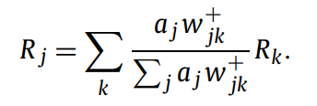
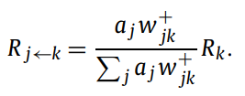
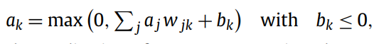
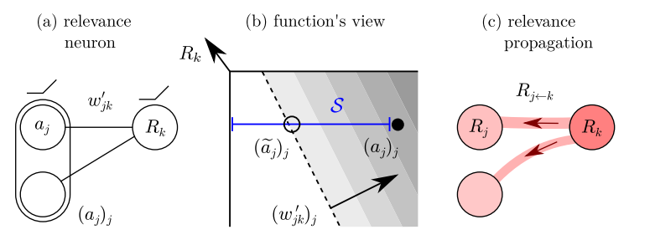
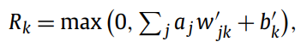
Deep Taylor Decomposition (LRP-α1β0)
We then preform taylor decomposition and search for nearest root point, getting the relevance redistibuted from one neuron to its predessesor :
When β = 0 , the propagation rule turns to:
Neuron activation:
Summing all the neurons k to whicj j contributes is equivalent to the propagation rule of LRP-α1β0
Assuming Relevance = a * ((+)constant), we can define a relevance neuron:
W'jk = wjk * c and b'k = bk * c k
Notes:
Having beta be equal to zero, we can simplify the propagation rule to this, and the activations of the neurons can be modeled by this, which returns positive activations only. Then we can define the relevance of the neuron and then perform Taylor decomposition by taking a root point at the limit of zero activation. We then search for the nearest point shown by the blue line. Doing this for every neuron in the layer and summing them up the relevance yields the same propagation rule as LRP-α1β0.

Slide 20
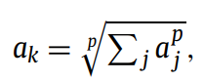
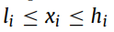
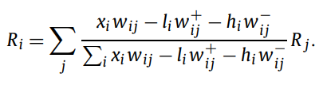
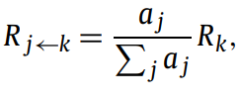
Rules for Special Layers in Deep Taylor Decomposition(LRP-α1β0)
Input layer Rule:
Pooling Layer Rule:
Modifies root search direction to remain inside the
input domain( )
(ex. pixel values)
New propagation rule:
Layer output:
Where, aj = activations within the pool
Possible propagation Rule:
Notes:
Special layers in LRP alpha 1 beta 0 require different propagation rules to be implemented. The input layer for one needs to consider the domain of the inputted data to make its prototype and needs a rule that takes that into account. A pooling layer would also need a new set of rules that consider the activations of a localized area. There are a variety of other layers that need rules to handle specific signals and many ways to implement them.

Slide 21
Maximizing Explainability in Models
Global layer wise structure:
Spatial pooling:
Fully connected layers unless needed for accuracy (avoids relevance losing meaning to predicted concept)
Train with dropout layers (encourages relevence to be distributed to task relevant neurons
Use Sum pooling layers, espetially over other types of pooling layers ( directly embedeble in deep taylor framework)
Linear layers in DNN architecture:
Negative or zero constraint biases in Linear layers
Notes:
To make our models as explainable as possible we must keep in mind a few things. With the global layer wise structure, we want to avoid using fully connected layers as much as possible if we can still maintain the accuracy. This allows the relevance to be passed on to more task relevant neurons and be more related to the concept being predicted. Training the model using dropout layers allows filters to work better by encouraging relevance to be passed on to more task related neurons. For providing spatial invariance, Use sum pooling since its already embedded into the deep Taylor framework and is easier to implement compared to other methods and makes it easier to interpret outputted data. Having negative or zero constraint biases in Linear layers makes the LRP preform closer to a deep Taylor decomposition, as well as further scattering the networks activations which encourages relevance to be passed on to a limited number of neurons.

Slide 22
Which Rule to use
As a default use deep Taylor decomposition(LRP-α1β0)
Stable behaviour and well understood theoretically
If results are still unsatisfactory other propogation rules could yeild better results
Look for best suited propagation rules to meet heatmap criterion
Can also change hyperparemeters up hyperparemeter(ei. α,β) between layers
If certain features could contradict prediction, use (LRP-α2β1)
able to use negative relevance
Notes:
As a default it is commonplace to use LRP alpha 1 beta 0 rules as they are stable and well understood theoretically. However, it does not consider negative relevance. Consequently, when there is predictive uncertainty and some inputted variables might contradict a certain class, the model will need to switch to using LRP alpha 2, beta 1 to consider negative relevance. If results are still unsatisfactory there are many other propagation rules that can be set for the neurons that might be able to provide better prototypes.

Slide 23
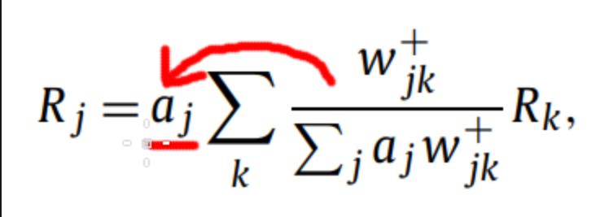
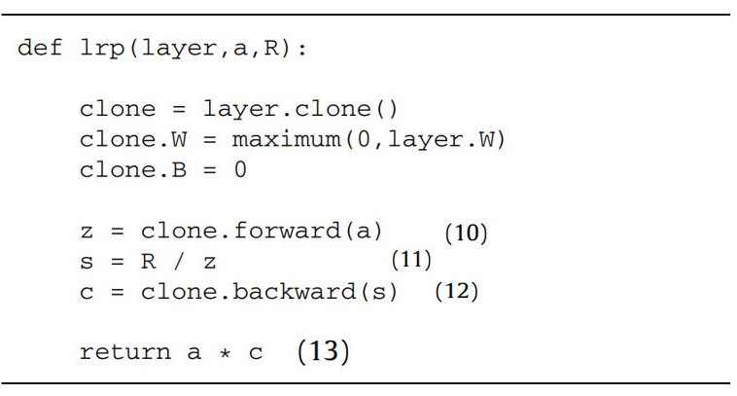
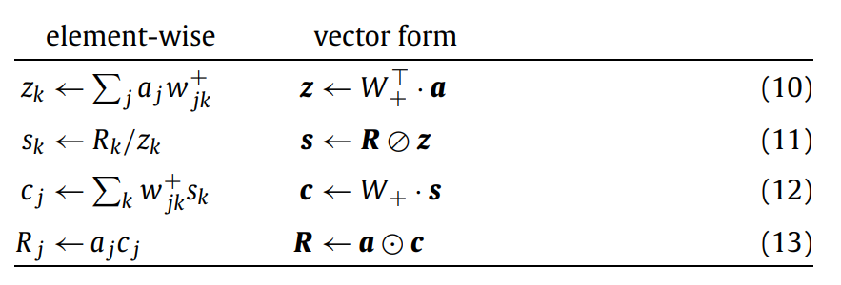
Implementing LRP-α1β0 in code
(Using fully connected or convolutional layers)
Algorithm takes in:
Moving the activations outside the sum
layer to propagate through
a = activations at layer input
R = relevance scores at layer output
We can obtain these four equations:
Notes:
By using fully connected or convolutional layers and moving the neuron activation outside of the sum, we can produce these four-computations expressed in vector form. For each layer we can use this algorithm to compute the redistributed relevance at the layer input. This algorithm takes in the layer that should be propagated through, the activations of the input layer and the relevance at the layer output. Going through this algorithm, the layer is cloned. The layers weight matrix has all its negative values set to 0 and bias set to 0. We can use follow the equations on the left to get the redistribution of relevance. The complexity of Layer wise propagation scales linearly with the forward pass, off some constant related to the rule used. Times 3 for LRP a=1, b=0 and times 5 for general a and b values.

Slide 24
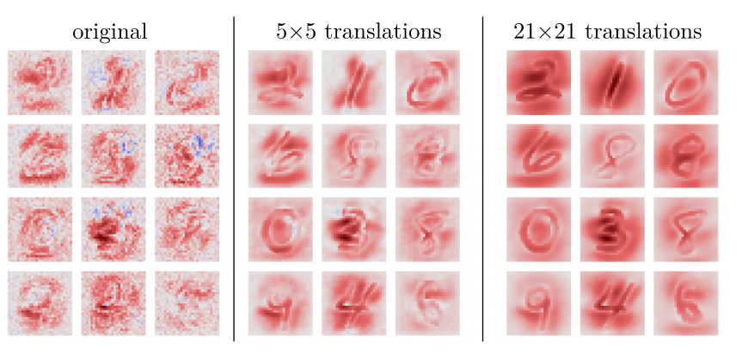
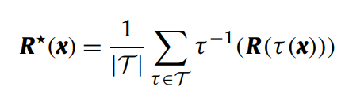
Denoising heatmaps
Problems with heatmaps:
Translations:
Can look noisy, either from data, noisy first layer filters or a large stride parameter ( used in down sampling activations of a layer)
Too few translations and heatmap will remain noisy
Too many and model will produce erratic decisions
Preserves spatial resolution(not the same as heatmap blurring)
Solution = Denoising:
Take in the input image along with slightly translated versions, recombine the heatmaps by inversing the translation and adding then averaging them
τ , τ^−1 = translation and its inverse
T = set of all translations
(5X5) = up to 2 pixels in all directions
Notes:
For some models that were not able to optimally train or structure, the heatmaps produced can turn out noisy. We can put multiple slightly translated input images int to the network to produce multiple heatmaps. Which can then be inversely translated, added, and averaged up to provide a less noisy heatmap. Using to small of a translation window will not give a significant difference. While using too large of a translation window might give erratic results. This technique is different from simply blurring the heatmap as the spatial resolution is conserved.

Slide 25
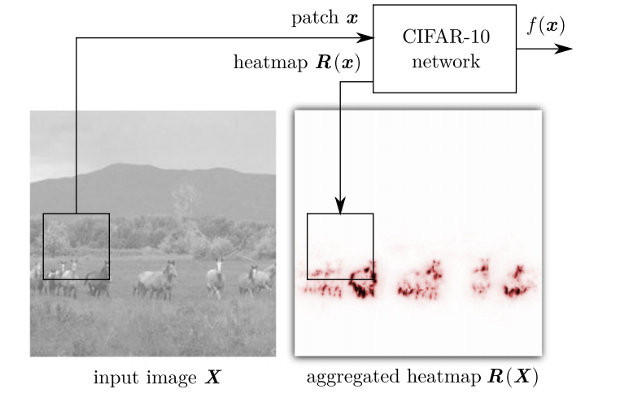
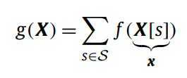
Sliding window method
If Input is too large:
Go along the input image and feed in windows to the model along all possible locations
Then splice together outputted heatmaps
X = image
s = window size
S = set of all locations
Notes:
In some cases, the input size of the data might be larger than what the model was trained on or does not match the expected input parameters. We can us the sliding window approach and select patches along all possible locations of the input and we then put them through the model. The outputted heatmaps are then spliced together to get the larger desired heatmap.

Slide 26
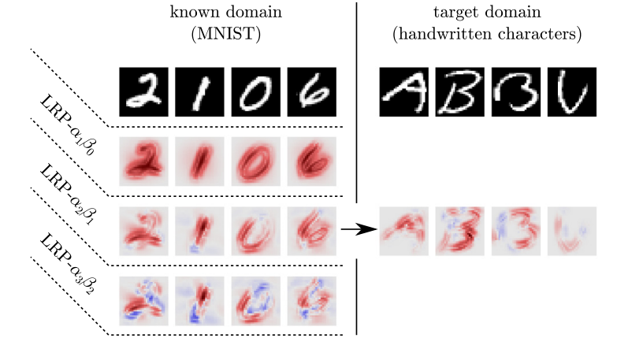
Evaluating quality of explanation
Transfer problem to simpler task
Easier to identify useful parameters on simple task
Try to explain decisions using those parameters
Simpler task is not always available
We can see:
Both models have importance on the handwritten strokes
LRP has negative relevance on the B heatmap when bar is to far
Notes:
To evaluate the explanation of our model we can test it out on a simpler related problem to make it easier to see if an explanation is good or bad. In this example we want to explain the decisions of a DNN trained on a handwritten character dataset. By finding the relevant parameters found on a related MNIST dataset, we can then apply those to the original problem. Comparing the heatmaps we have in the picture we can see they are similar in terms of putting high relevance on the handwritten strokes and contain a similar amount of negative relevance. If were unable to find a simpler task we will need to use another quantitative way of characterizing a good explanation.

Slide 27
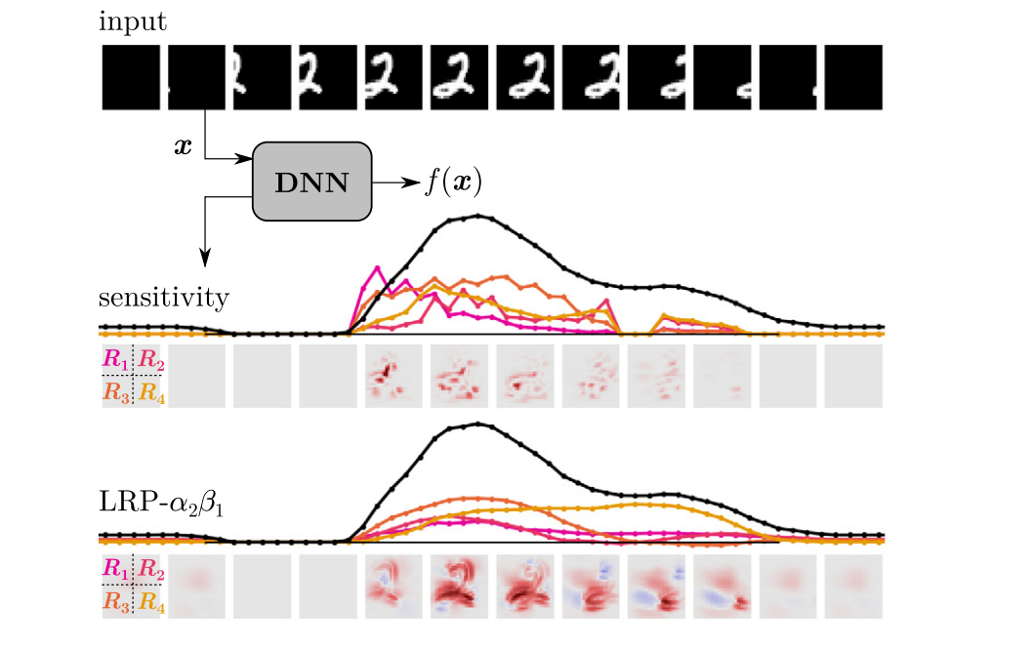

Explanation continuity
If two data points are almost equal, their explanation should be as well
The difference in relevance should not change much with similar inputs
LRP can offer a more continuous explanation
Notes:
For an explanation to be considered good, it must not give drastically different explanations from similar inputs. The explanation continuity can be quantified by looking at the strongest variation in relevance from two almost equivalent inputs. If the difference between their relevance is large it might not give the continuous explanation we are looking for. With sensitivity analysis and simple Taylor decomposition, they are more strongly exposed to derivative noise and as we can see from this example do not provide as continuous relevance score like Layer wise relevance propagation and are therefore worse at providing a continuous explanation like LRP.

Slide 28


Explanation selectivity
Pixel flipping:
Patches are sorted by highest relevance and then removed to see difference on the function value
Higher drop means patch is more relevant
Notes:
Another explanation technique is explanation selectivity, using a method called pixel flipping, where patches of an input are sorted by highest relevance and then removed to see the difference it has on the function value. If removing a patch removes a lot of relevance, then that patch contains features that highly influence the model’s prediction, LRP a=2b=1 on average scores the best since it considers the negative relevance scores as well. Using patches instead of pixels lets the analysis focus on removing actual content from the image rather than individual pixels, which can help us determine high relevance feature more easily.

Slide 29

Model validation
Validating a model by testing it on a validation set might not always be reliable
Preforming LRP allows us to interpret the model's decision and better asses the model
Comparing these Models:
Both models had similar classification accuracy, but
The DNN looked for the contour of the horse
The Fisher vector model looked for a copyright tag on the inputted horse photos
Notes:
Validating a model can be done by seeing how well the model preforms on some validation set. Since this is only a proxy for the true error and can differ from the true distribution. LRP can help validate the model by allowing us to interpret its decisions. One example of LRP helping validate models is shown here. We have two models that classify images with horses, one trained by a convolutional DNN transferred from ImageNet, and another with Fisher vector classifier on PASCAL VOC 2012 images. Both these models came up with a similar classification accuracy on the validation sets, Applying an LRP procedure on both models gave us these heatmaps. You can see the DNN heatmap seems to have high relevance in the contours of horses. While the Fisher vector classifier heatmap gives high relevance to the bottom left corner. That is because it was trained on a dataset where all the images of horses contained a watermark there. It would then give high relevance to these images since that feature was common to the horse images inputted. If we only looked at the validation error, we would have thought the models would perform similarly on all datasets, but inputting photos of horses with no watermarks drastically decreased the accuracy of the Fisher model.

Slide 30

Analysis of scientific data
Used in study to map DNA sequences to protein binding sites
Applications with scientific data:
Used to help shine light on what features are important and how much they influence the model's prediction
Notes:
Methods that can explain the decisions of Deep neural networks are becoming more and more useful in scientific research. Deep neural networks are being used in many fields and methods such as Layer wise propagation can better inform researchers on the decisions these networks are making. In relation to bioinformatics, they are being used to make sense of the human genome. One study trained a convolutional network to map DNA sequences to protein binding sites. Where the relevance score of each nucleotide was measured based the effect mutating it, had on the prediction, allowing them to explain which sequence of nucleotides are most relevant to their model.

Slide 31
Thank you
Notes:
Thanks for listening.

